Slide 1
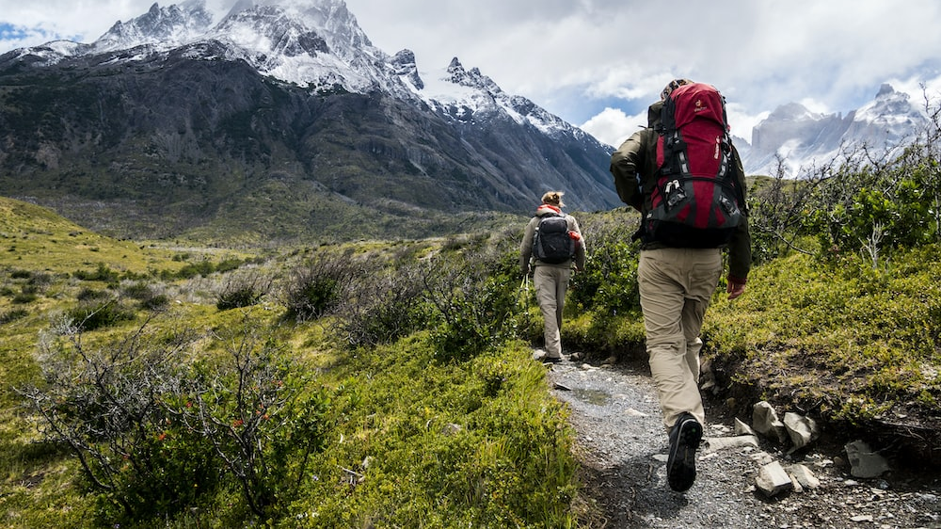
Outland Adventures

Slide 2
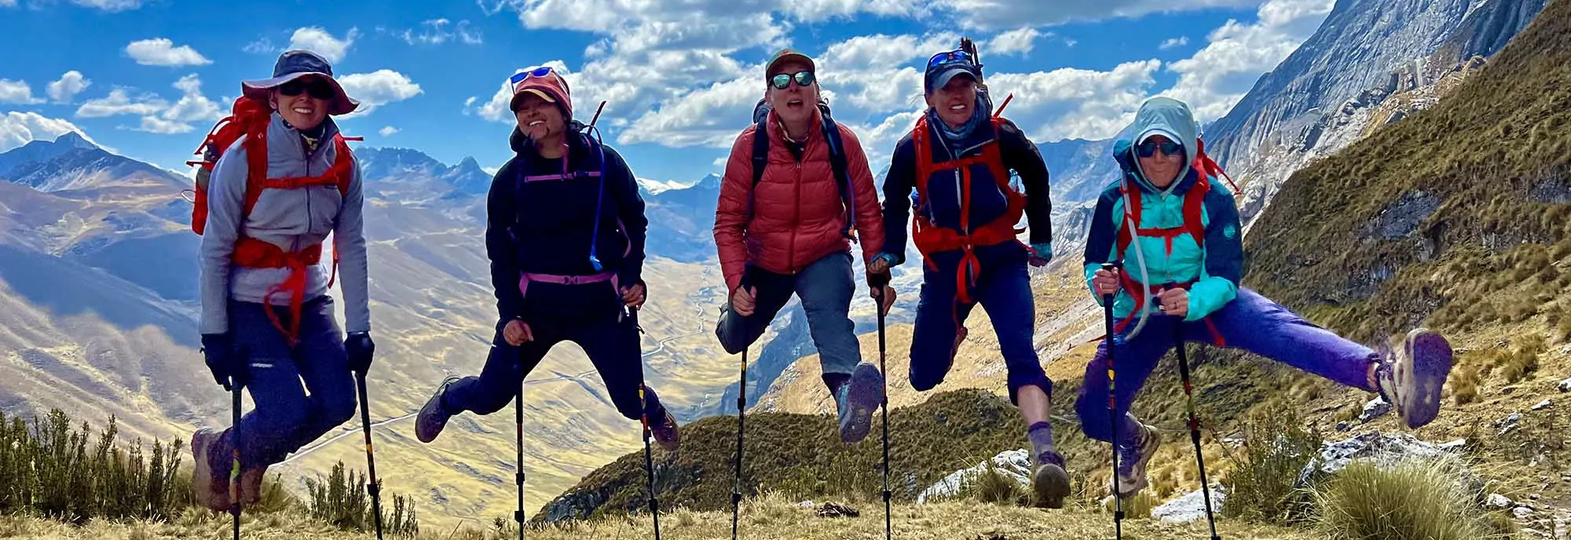
Juan Taylor Michelle Choe Chris Kaiser Estiven Hernandez Julia Gonzalez
Team Members

